Slide 1
Industry 4.0
Stéphan André, Jean De Meyere, Laurent Roy

Slide 2
Outline
Background
Problem
Solution(s)
Process & Nature

Slide 3
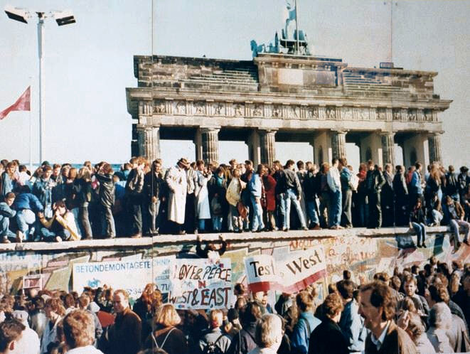
I. Background
„Europe as we have today has been forged in the time of crisis”

Slide 4
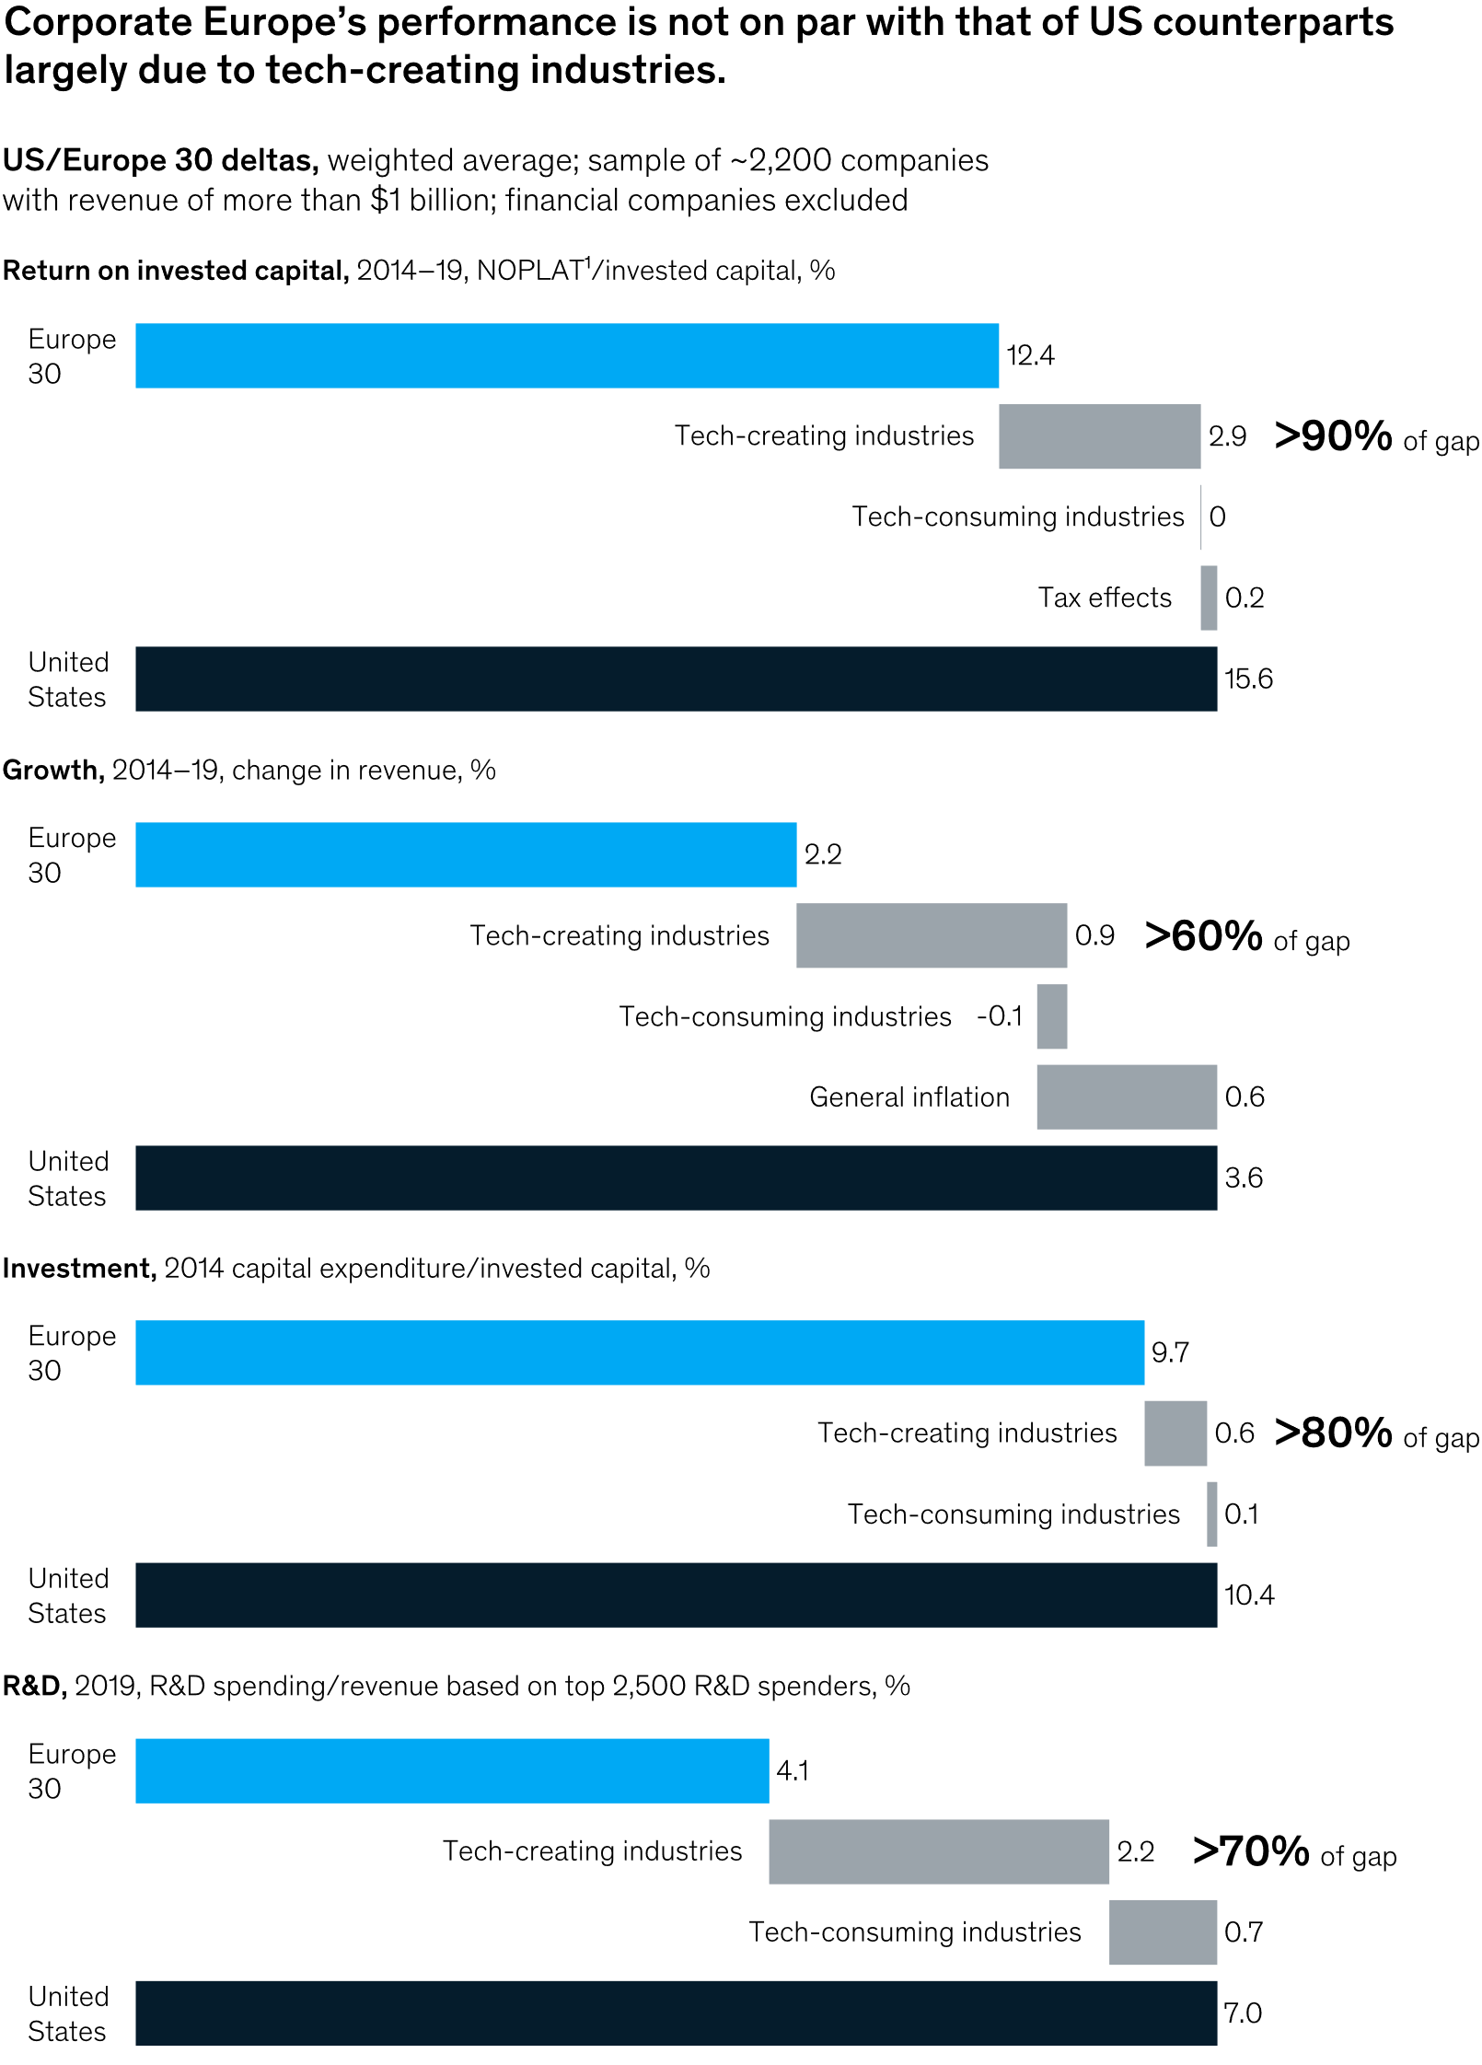
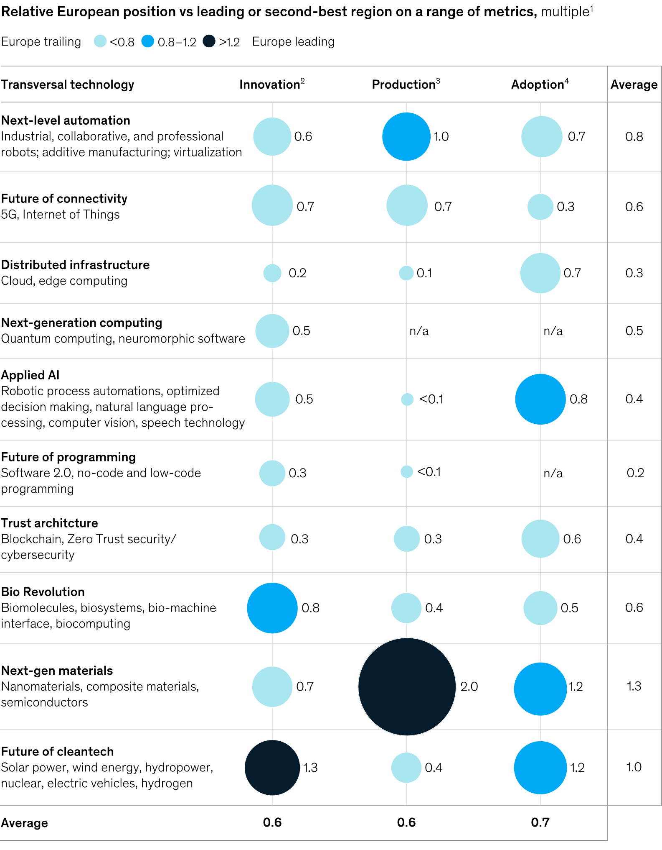
I. Background
46% of EU businesses took action to become more digital vs. 58% in the US
61% of EU businesses use advanced digital technologies vs. 66% in the US

Slide 5
II. Problem

Slide 6
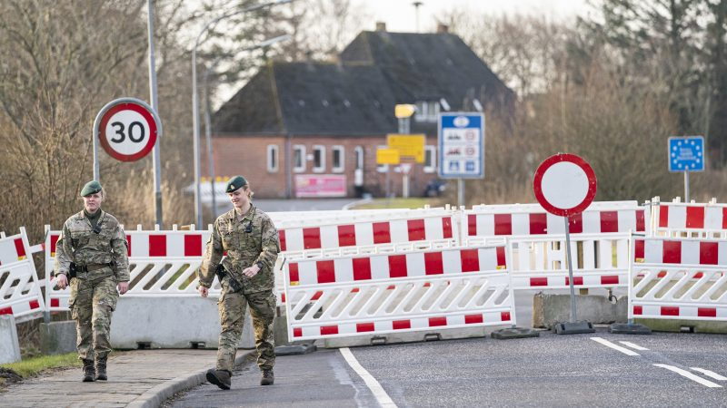
II. Problem

Slide 7
II. Problem
The four freedoms of the Single Market must be upheld
We must get a hold of and address our strategic dependencies
The green and digital transition is more important than ever

Slide 8
III. Solution(s)
1. Strengthening the Single Market Resilience
Single Market Enforcement Taskforce (SMET)
Forum between EC & MS
+ Harmonised standards
+ Electronic form for posted workers
+ Market surveillance
Single Market Emergency Instrument (SMEI)
Consistent application
Agile governance
Targetted toolbox
+ Solvency risks of SMEs
DMA
DSA

Slide 9
III. Solution(s)
2. Dealing with Dependencies: Open Strategic Autonomy in Practice
Bottom-up analysis of dependencies (cooperation)
Standardisation (Regulation)
Important Projects of Common European Interest (IPCEI)
Ensure resilliance of SMEs
Guidance on public procurement
International partnerships and industrial alliances
Distorsive effects of foreign subsidies (Regulation)

Slide 10
III. Solution(s)
3. Accelerating the twin transitions
Review of :
Competition rules
State aid
Broadband guidelines
Co-creation of transition pathways across industrial ecosystems
Recovery efforts + multi-country projects
Digital Europe Program:
Digital Innovation Hubs
European Innovation Council
Update of EC Trade Policy Review
Horizon Europe Program and Innovation Fund
European Skills Agenda & Skills Roundtables
Data Act
AI Act

Slide 11
III. Solution(s): Concretely

Slide 12
IV. Process & Nature
Name | Type of instrument | Basis | Procedure (for legal acts) | Current stage/status
Single Market Emergency Instrument (SMEI) | Regulation | 21, 45, 114 TFEU | Ordinary Legislative Procedure (OLP) | Proposal, 19/09/2022 Currently in first reading by EP
Digital Markets Act (DMA) | Regulation | 114 TFUE | OLP | Adopted, 014/09/2022
Digital Services Act (DSA) | Regulation | 114 TFUE | OLP | Adopted, 19/10/2022
Standardisation Regulation | Regulation | 114 TFUE | OLP | Adopted; 25/10/2012 – might be amended
Foreign Subsidies distorting the Internal Market Regulation | Regulation | 114 TFUE 207 TFUE | OLP | Adopted, 14/12/2022
Data Act | Regulation | 114 TFUE | OLP | Proposal, 24/02/2022 Currently in first reading by EP
AI Act | Regulation | 114 TFUE 116 TFUE | OLP | Proposal, 22/04/2022 Currently in first reading by EP
Review of existing EU law (competition/trade policy/broadband allocation) | Regulation, directive or other initiatives? | 101, 102, 103,… TFUE? 207 TFUE? 114 TFUE? | ? | Internal Procedure at the EC?

Slide 13
IV. Process & Nature
New Regulations – (DSA, Foreign Subsidies, SMEI,…)
Amendment of existing EU Law (Standardisation, competition, …)
International Negociations
Cooperation/discussion between the EC, MS and other stakeholders
SMET
Assessment on Strategic Dependencies
European Skills Roundtables
…
Funding Initiatives
Horizon Europe
Digital Europe
Recovery Funds
IPCEI
…

Slide 14
Thank you very much!

